Slide 1
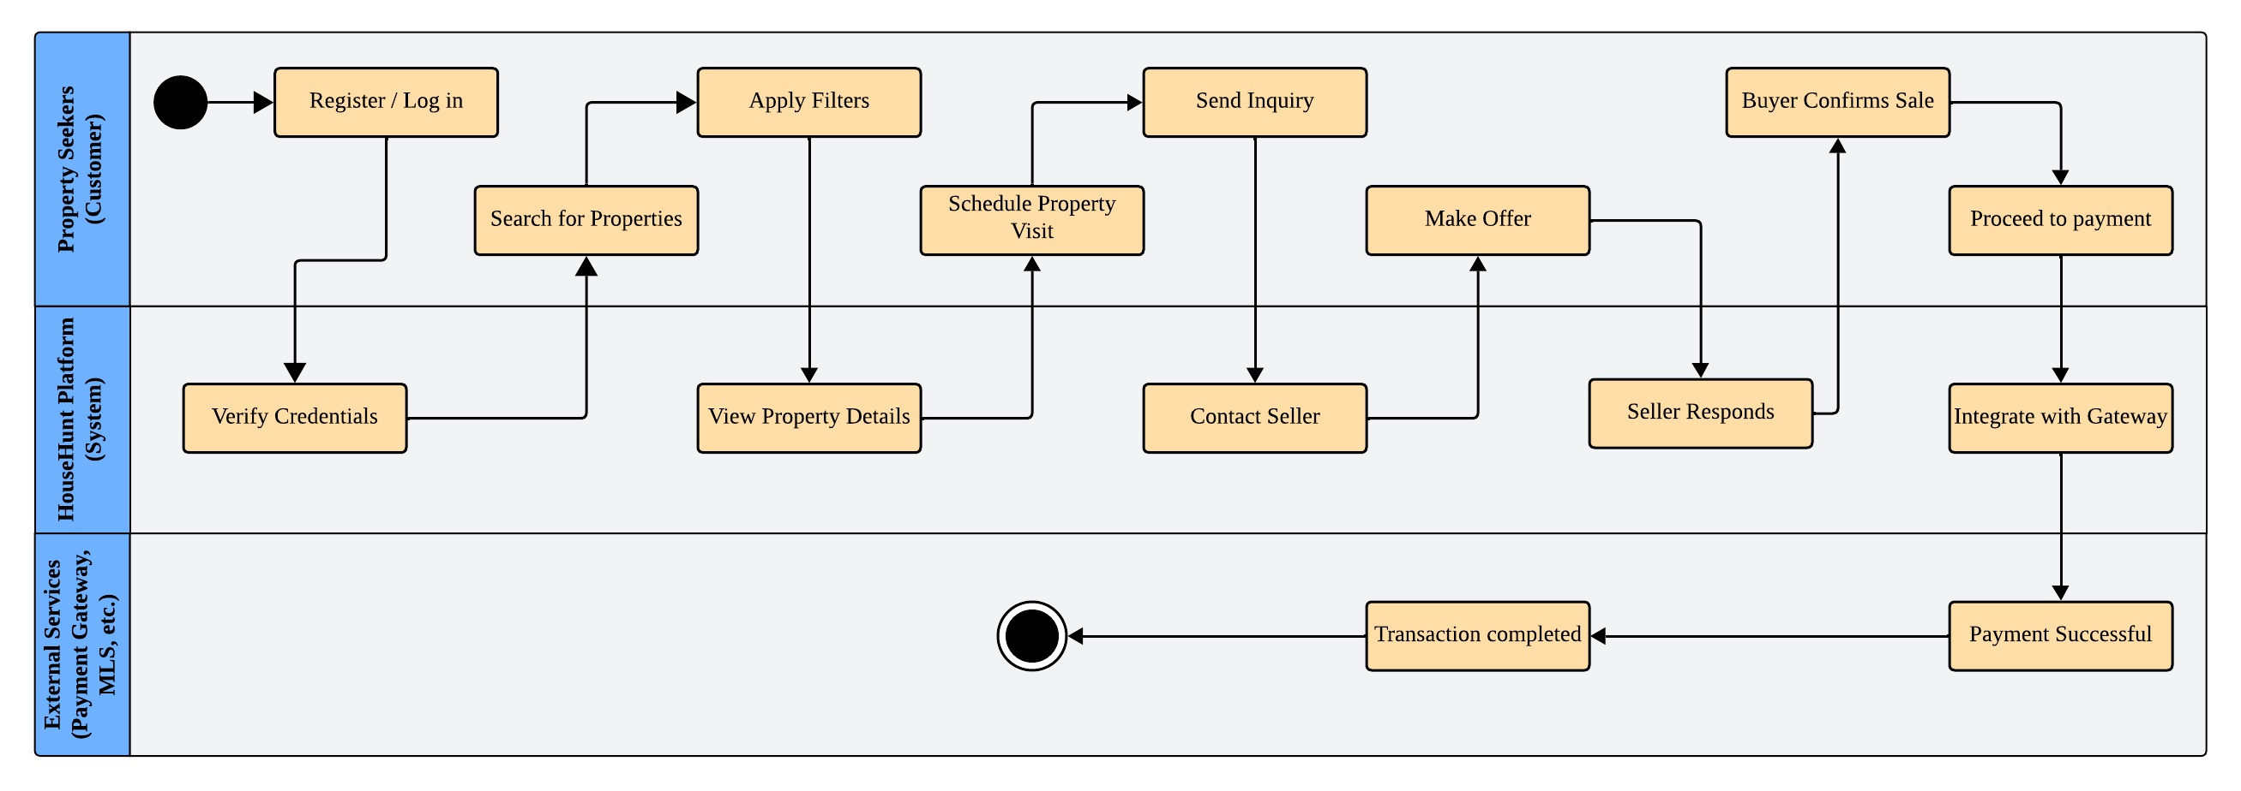
UML Activity Diagram: House Hunt

